Slide 1
SUBMITTED BY : a .ROSY KASTHURI MARIE YAGAPPA
MINIPROJECT-2
ONLINE BANKING SYSTEM USING SWING FRAMEWORK

Slide 2
TECHNOLOGY USED:
This project is completed using Java swing with SQL database connectivity.
JDK Eclipse – 15.0.2
MySql connector – mysql-connector-java-8.0.27

Slide 3
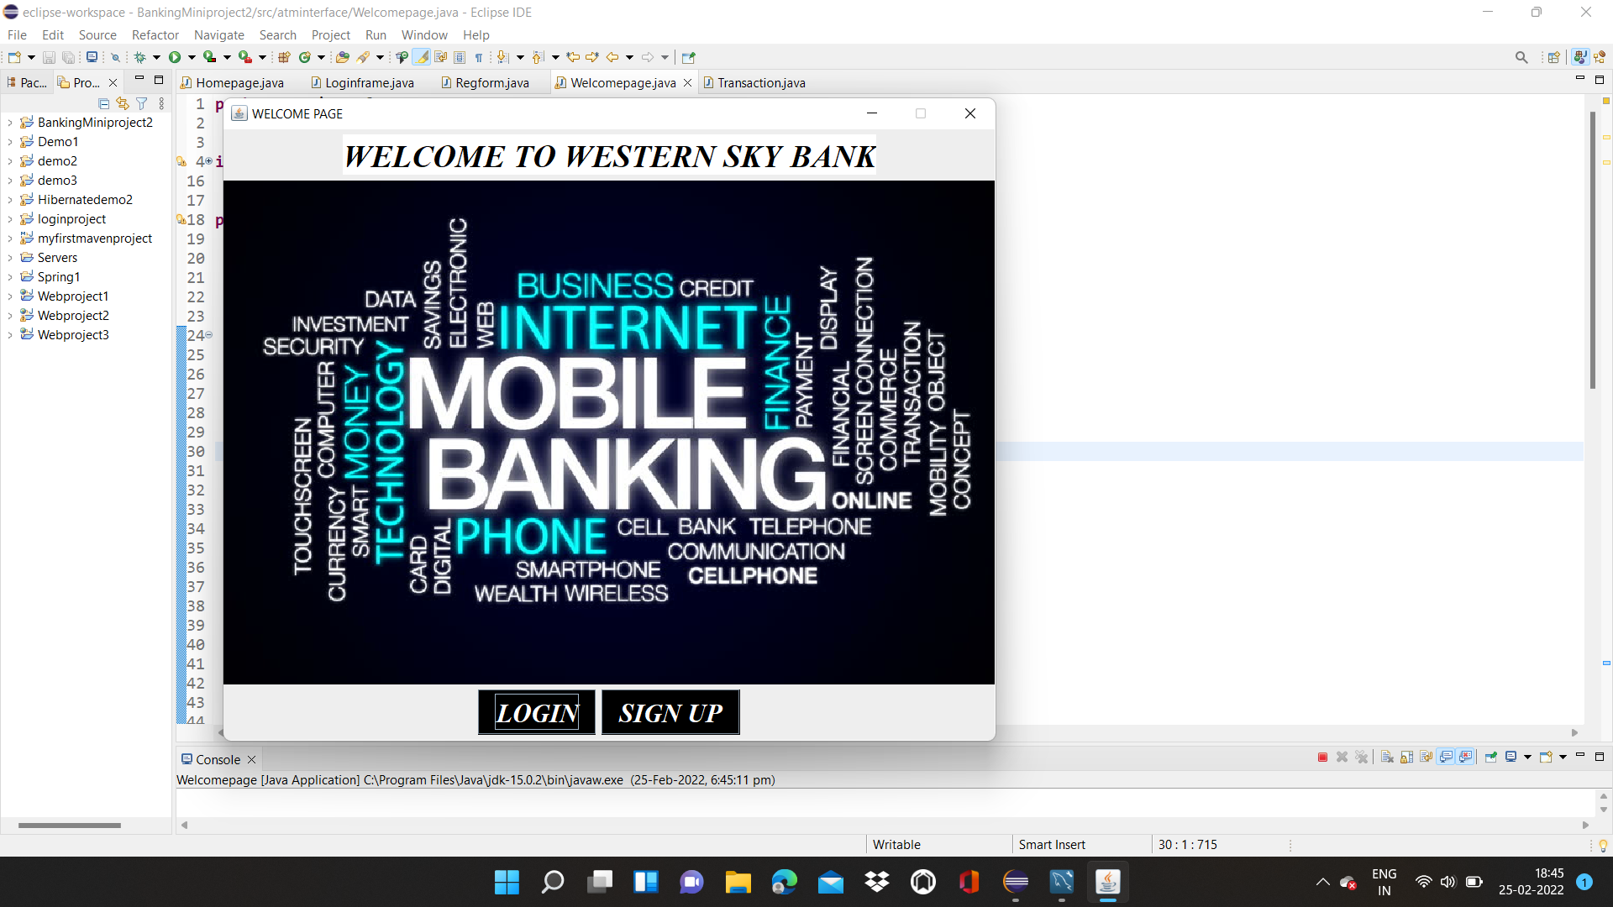
WELCOME PAGE:
This is a welcome page of a bank and it contains login and signup button which contain another frame.
Here I have used label and image which is displayed on this frame.
While clicking on sign up button ,signup frame will be opened which is connected to database.

Slide 4
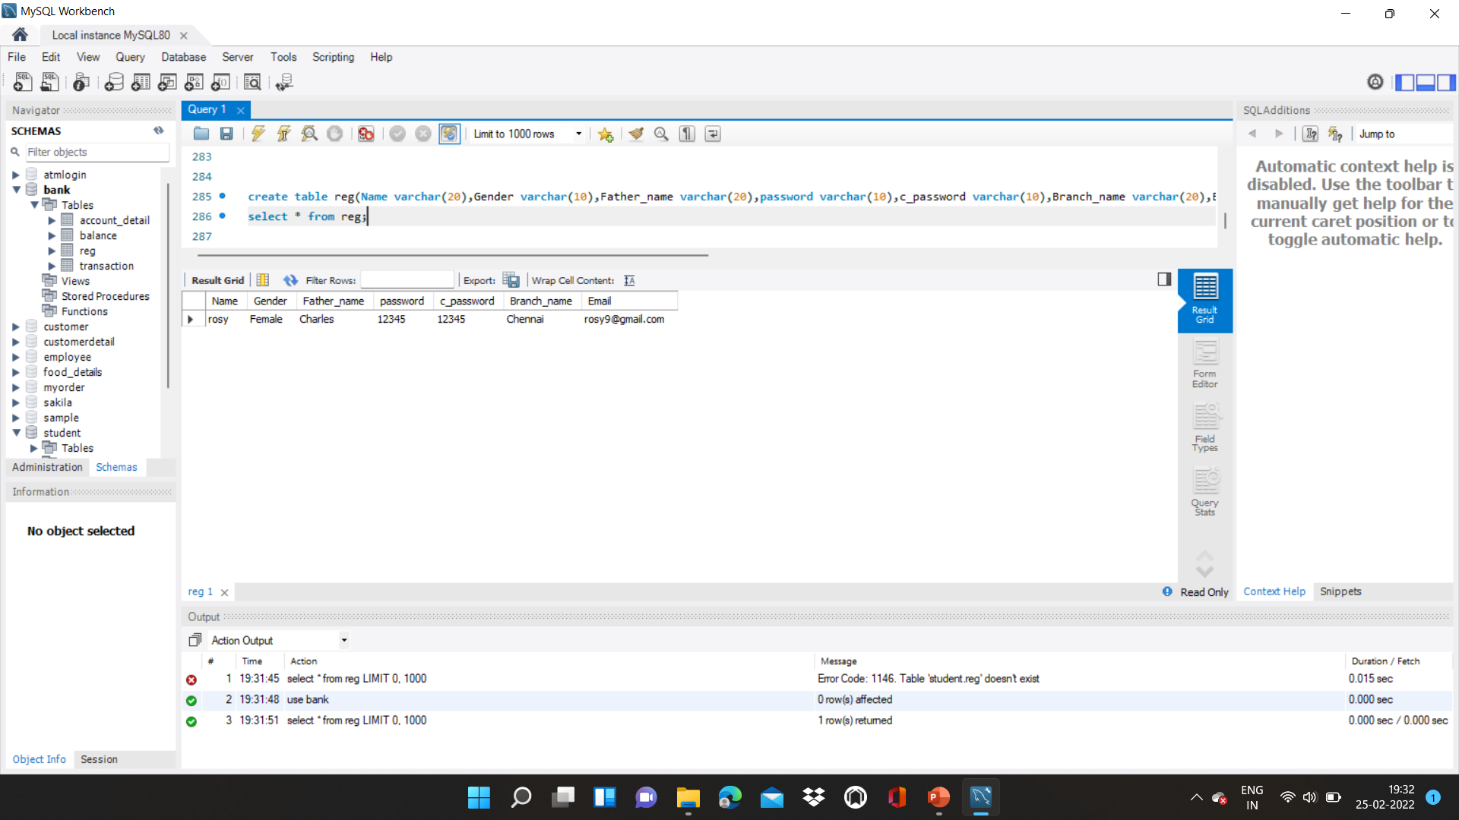
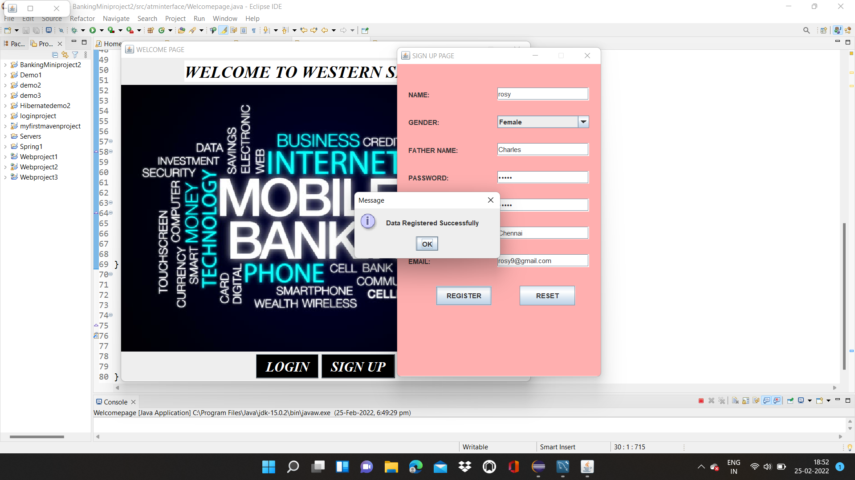
SIGN UP PAGE:
INSERTED DATA IN DATABASE:
Using this data , the login process can be done.
After clicking sign up, frame will be occur. This frame is connected to the database to store the data.
Here after filling the data, if I click register the data will be inserted/stored in the database.
Then inserted data can be used for login process.

Slide 5
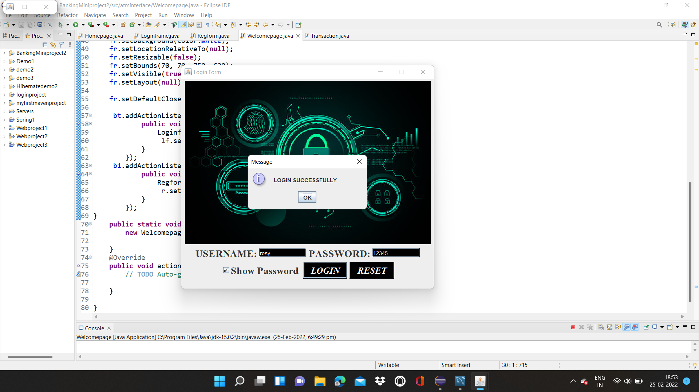
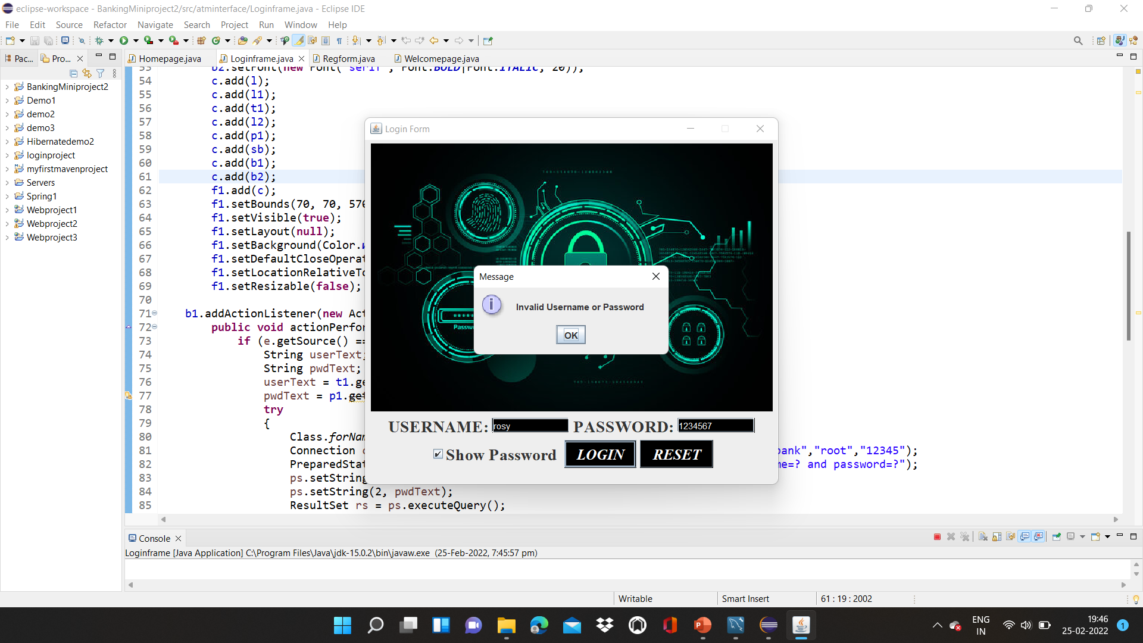
LOGIN PAGE:
This is the login page which contain username and password and two button login and reset.
Using data from database here the login process is done.
If invalid password & username enter it shows invalid username and password

Slide 6
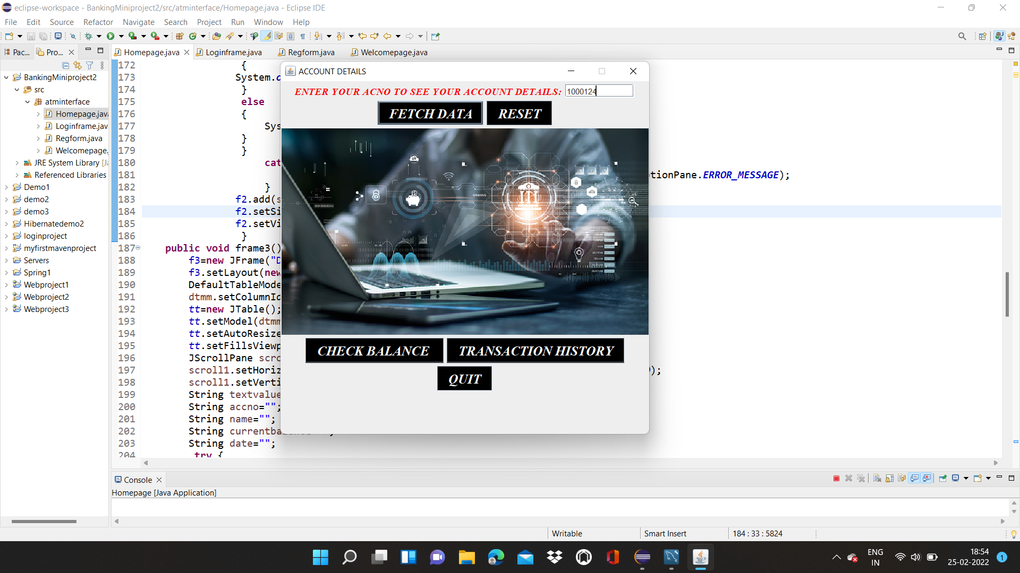
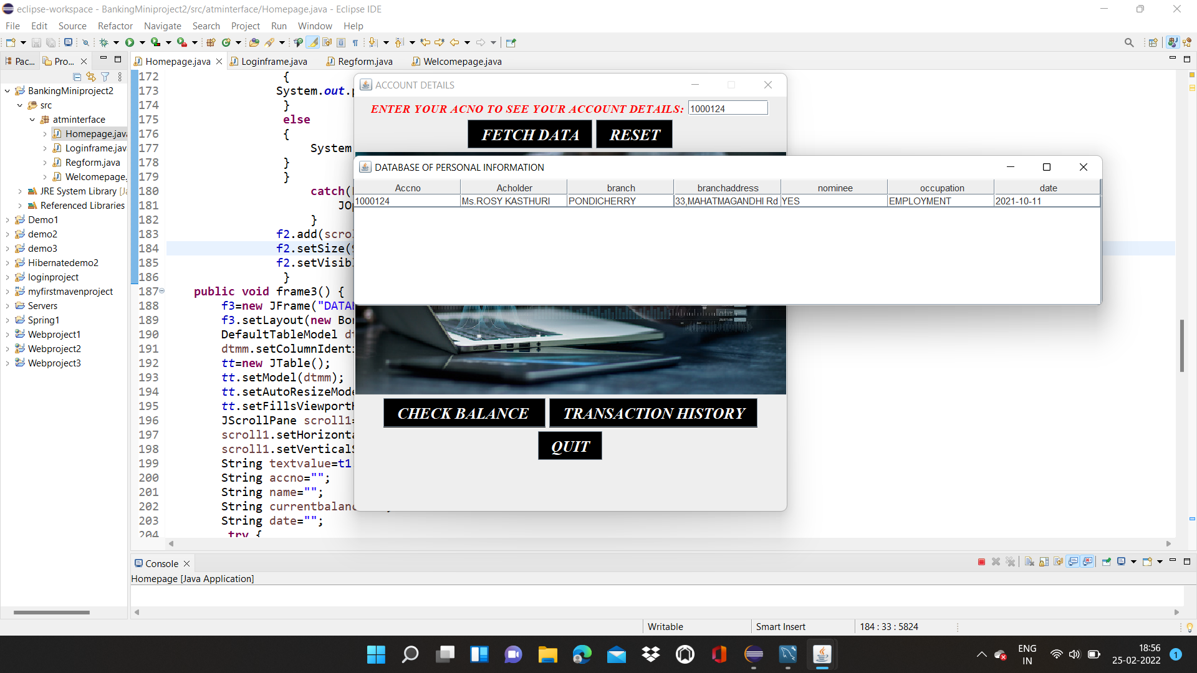
FETCHING DATA FROM DATABASE:
This is account details frame. This frame contains fetch data, check balance and transaction history.
After enter the acc.no it will fetch the data from the database and display it in the table.

Slide 7
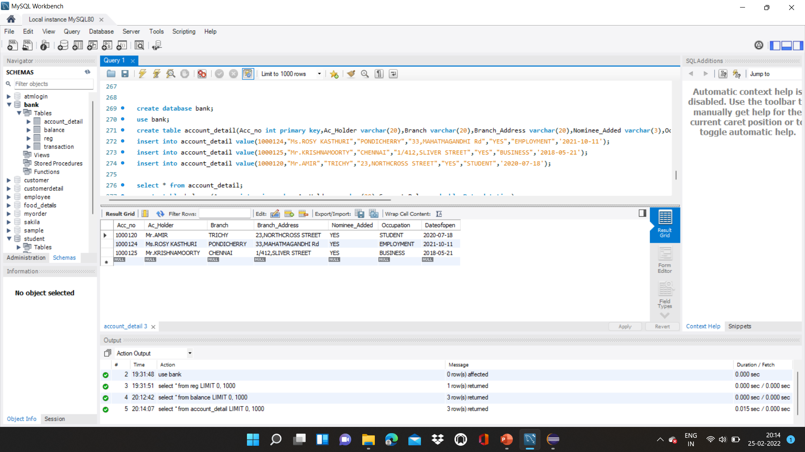
DATABASE OF ACCOUNT DETAILS:

Slide 8
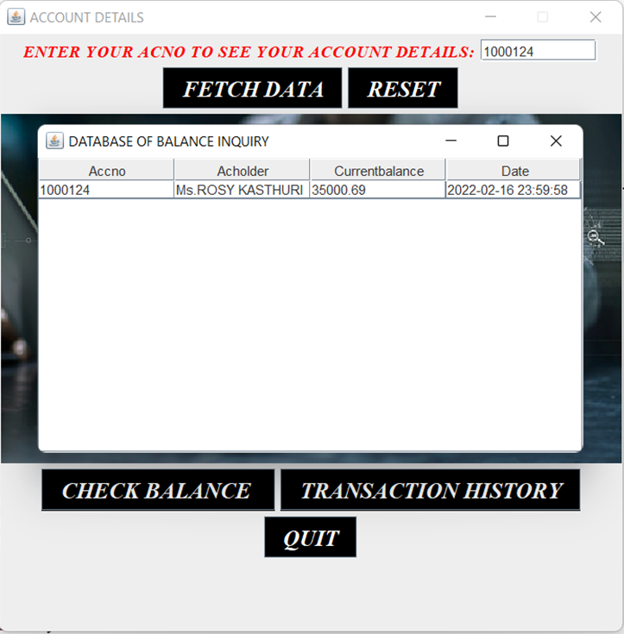
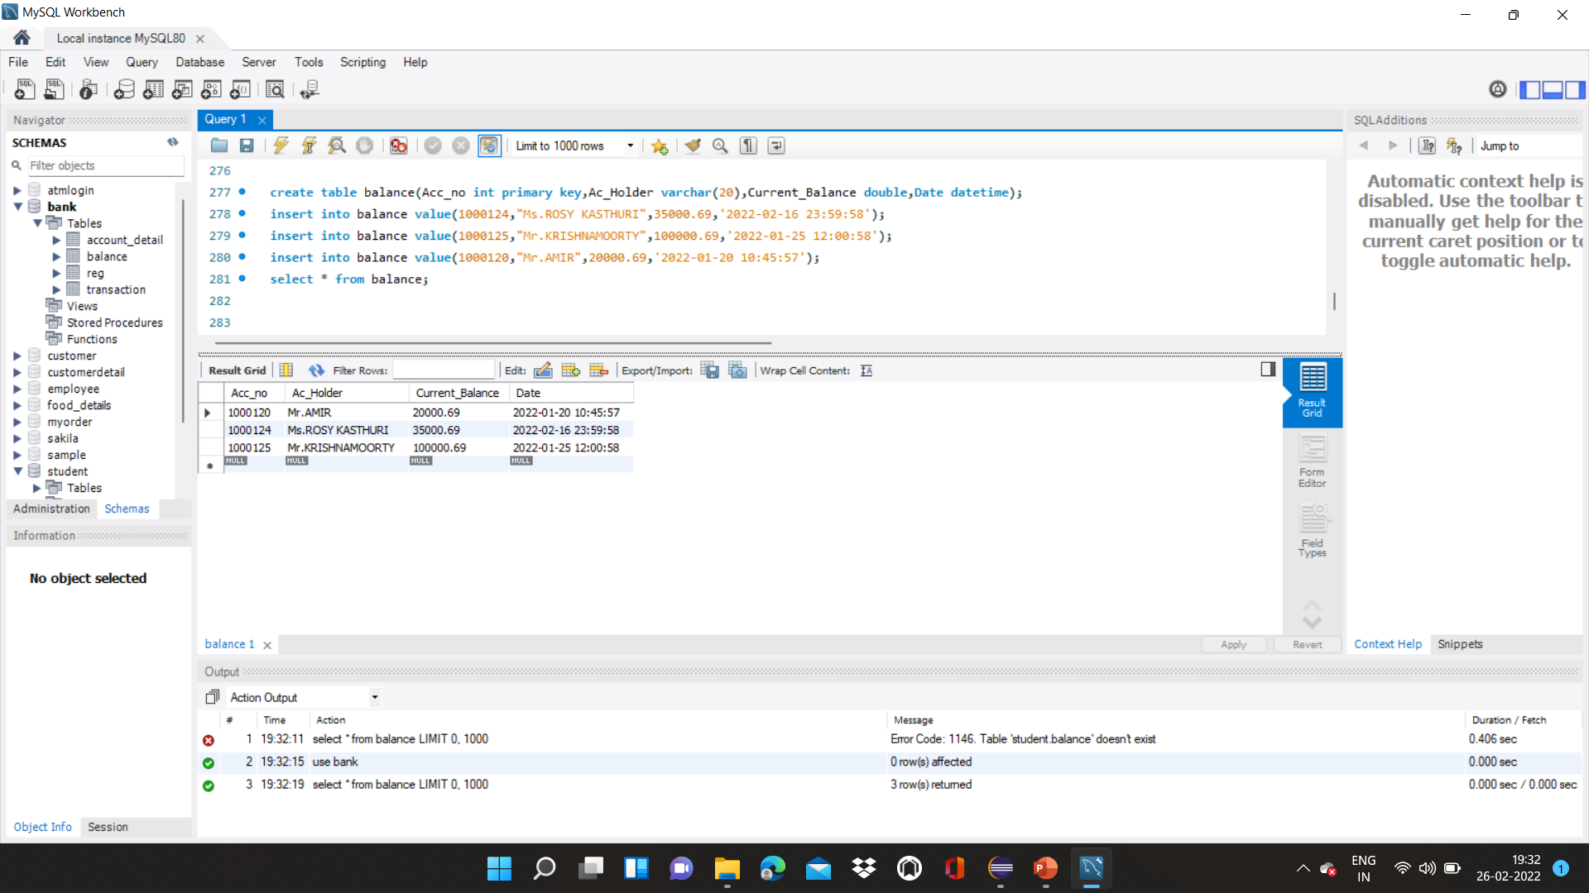
CHECK BALANCE:

Slide 9
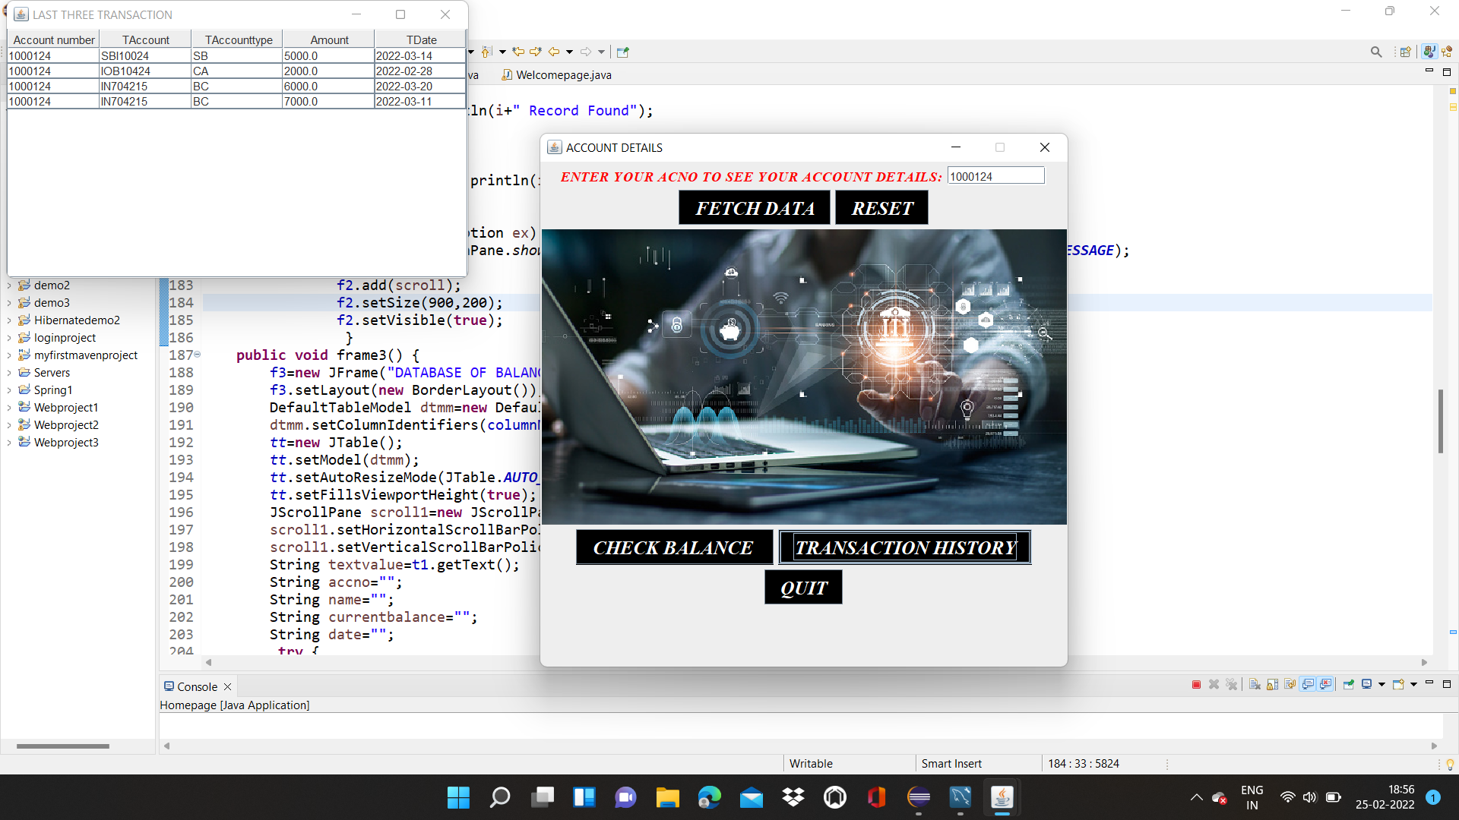
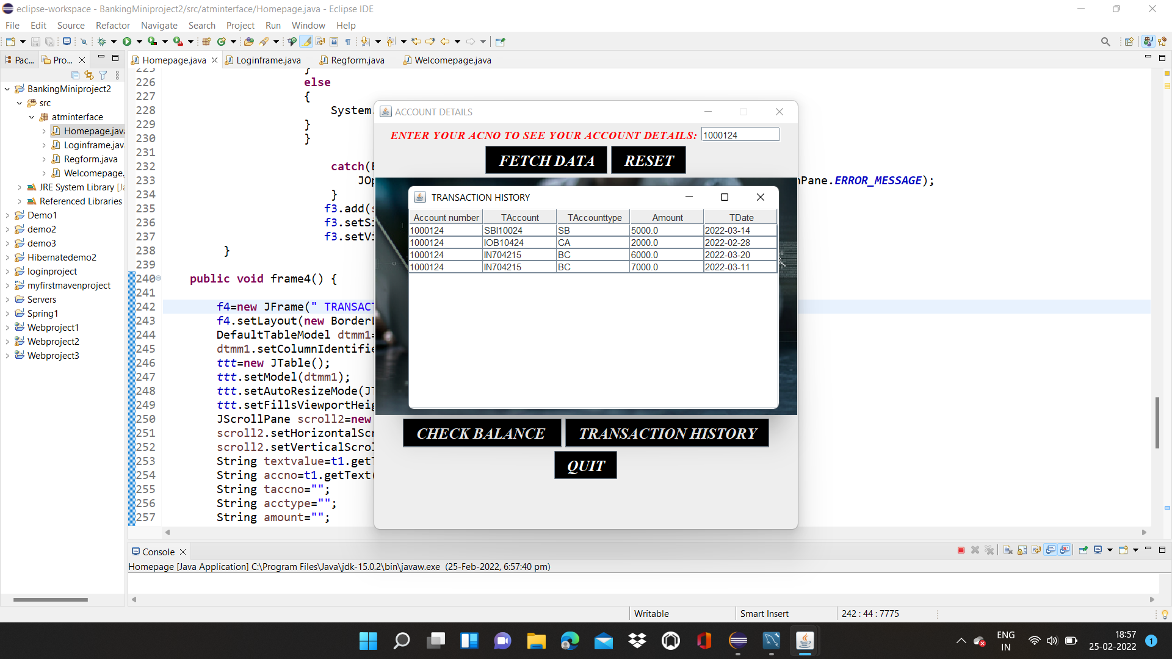
TRANSACTION HISTORY:

Slide 10
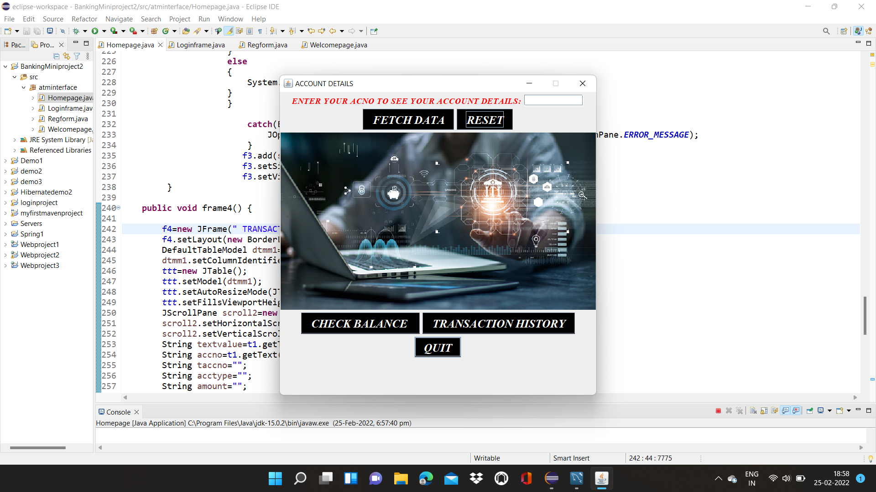
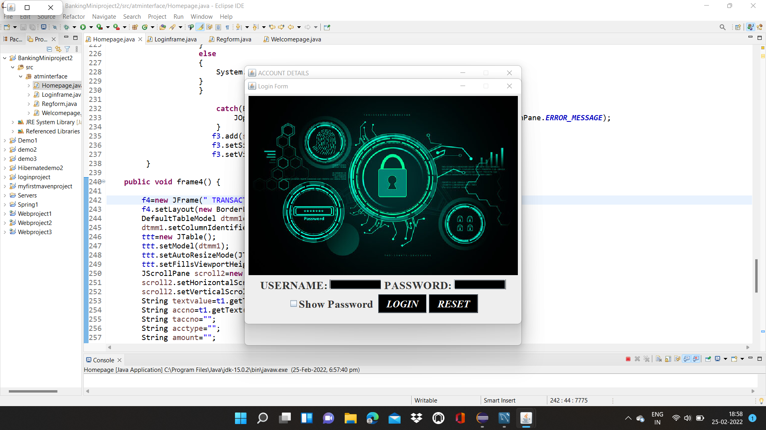
OUIT:

Slide 11
THANK YOU…

